Slide 1

2023年STP第三期暑期研修班
逻辑动态系统的鲁棒控制理论
李海涛
山东师范大学数学与统计学院
Email: haitaoli09@gmail.com

Slide 2
1. Background
2. Literature Review
3. Function Perturbation
4. Edge Perturbation
5. Illustrative Examples
6. Conclusion

Slide 3
1. Background
2. Literature Review
3. Function Perturbation
4. Edge Perturbation
5. Illustrative Examples
6. Conclusion

Slide 4

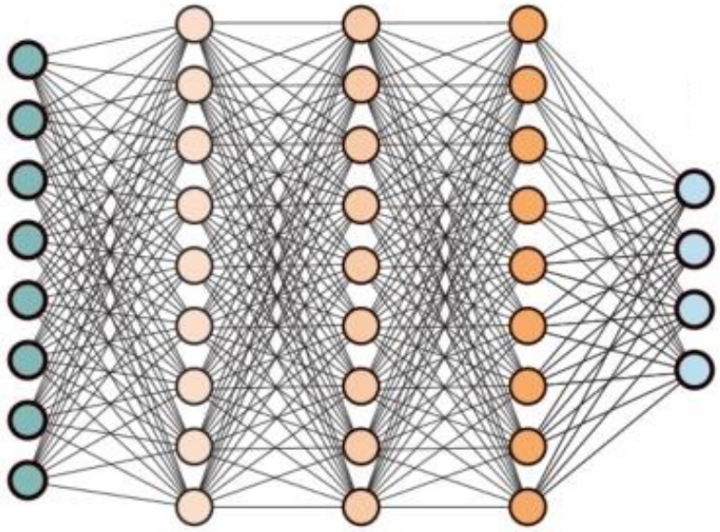

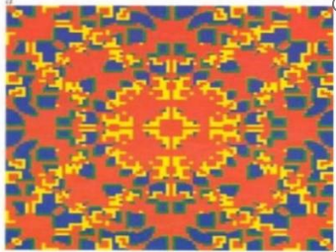
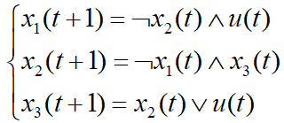

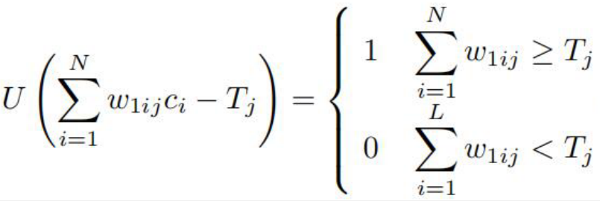
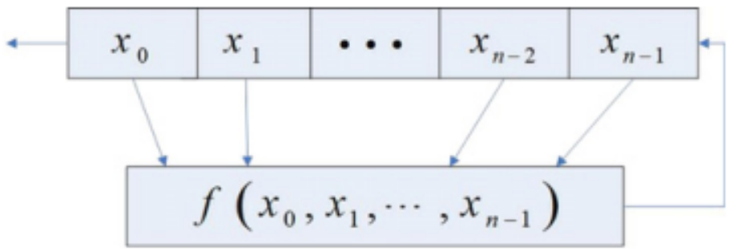
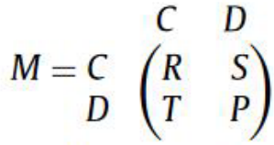
Background
Logical dynamical systems
In the last few decades, logical dynamical systems (LDSs) have been widely used in gene regulation, information security, electric vehicles, social networks, artificial intelligence, smart grid, and so on.

Slide 5
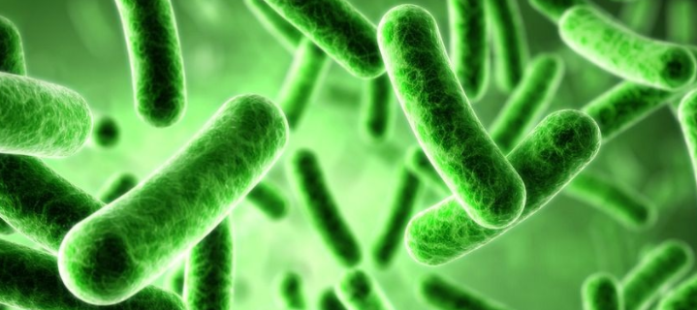
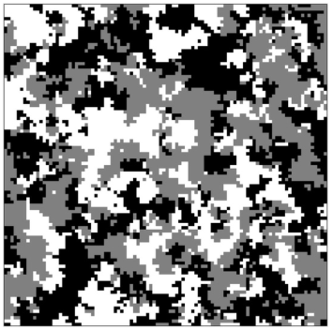
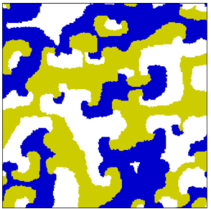
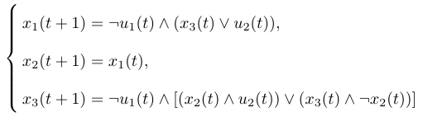
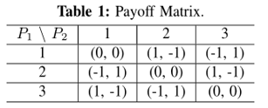
Background
Classification of LDSs: Boolean network, multi-valued logical network, mix-valued logical network.
Characteristics of LDSs: Parameter-free, Qualitative description, Large-scale network.
Lactose operon in E. coli
Rock-Scissors-Paper game

Slide 6
Background
Tools of studying LDSs
Veliz-Cuba et al. studied Boolean networks via polynomial representation.
[1] Veliz-Cuba, A., Jarrah, A. S., Laubenbacher, R., 2010. Polynomial algebra of discrete models in systems biology, Bioinformatics, 26(13): 1637-1643.
Hinkelmann et al. developed the ADAM software packages for the investigation of Boolean networks.
[2] Hinkelmann, F., Brandon, M., Guang, B., Mcneill, R., Blekherman, G., Veliz-Cuba, A., Laubenbacher, R., 2011. ADAM: Analysis of discrete models of biological systems using computer algebra. BMC Bioinformatics, 12: 295.

Slide 7

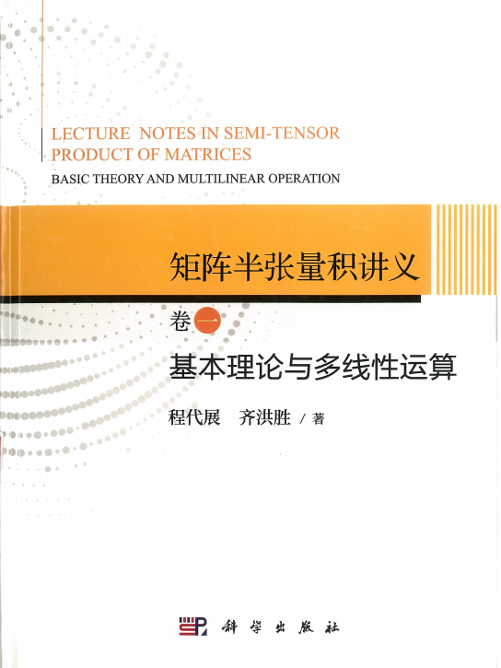
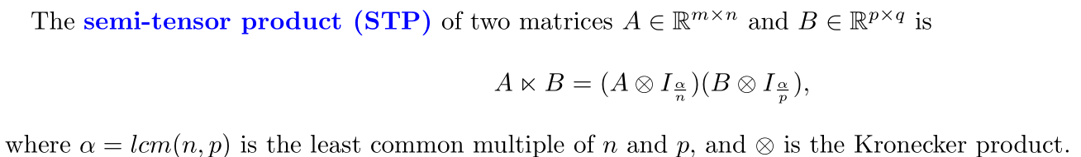
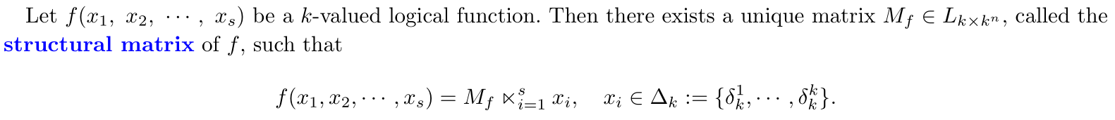

Background
Semi-tensor product of matrices

Slide 8
Background
Analysis of LDSs: controllability, observability, stability.
Cheng and Qi studied the controllability and observaility of LCNs via STP.
[3] Cheng, D., Qi, H., 2009. Controllability and observability of Boolean control networks, Automatica, 45: 1659-1667.
Zhou et al. converted the observability problem of PBNs into the set reachable problems.
[4] Zhou, R., Guo, Y., Gui, W., 2019. Set reachability and observability of probabilistic Boolean networks, Automatica, 106: 230-241.
Guo et al. proposed the concept of stability in distribution for PBNs.
[5] Guo, Y., Zhou, R., Wu, Y., Gui, W., Yang, C., 2019. Stability and set stability in distribution of probabilistic Boolean networks, IEEE Transactions on Automatic Control, 64(2): 736-742.

Slide 9
Background
Control of LDSs: stabilization, tracking, synchronization, optimal control, etc.
Li et al. proposed the reachable set approach for the control of LDSs.
[6] Li, R., Yang, M., Chu T., 2013. State feedback stabilization for Boolean control networks, IEEE Transactions on Automatic Control, 58(7): 1853-1857.
Li and Wang obtained all possible state feedback stabilizers for LDSs.
[7] Li, H., Wang, Y., 2017. Further results on feedback stabilization control design of Boolean control networks, Automatica, 83: 303-308.
Li and Wang eastabilished the Lyapunov theory for LDSs.
[8] Li, H., Ding, X., 2019. A control Lyapunov function approach to feedback stabilization of logical control networks, SIAM Journal on Control and Optimization, 57(2): 810-831.

Slide 10
Background
Control of LDSs: pinning, sampled-data, event-triggered control, etc.
Lu et al. proposed the pinning control appraoch for the stabilization of LDSs.
[9] Lu, J., Liu R., Lou J., et al., 2019. Pinning stabilization of Boolean control networks via a minimum number of controllers, IEEE Transactions on Cybernetics, 51(1): 373-381.
Lu et al. introduced the sampled-data control for the stabilization of LDSs.
[10] Lu, J., Sun, L., Liu, Y., et al., 2018. Stabilization of Boolean control networks under aperiodic sampled-data control, SIAM Journal on Control and Optimization, 56(6): 4385-4404.
Li et al. discussed the robust stabilization of LDSs via the event-triggered control.
[11] Li, Y., Li, H., Sun, W., 2018. Event-triggered control for robust set stabilization of logical control networks, Automatica, 95: 556-560.

Slide 11
Background
Applications: power system control, electric vehicles, feedback shift register.
Lu and Mei applied the STP method to power system control.
[12] 卢强, 梅生伟, 2012. 现代电力系统控制评述— 清华大学电力系统国家重点实验室相关科研工作缩影及展望, 系统科学与数学, 32(10): 1207-1225.
Kang et al. applied the STP method to electric vehicles.
[13] Kang, M., Wu, Y., Shen, T., 2017. Logical control approach to fuel efficiency optimization for commuting vehicles, International Journal of Automotive Technology, 18(3): 535-546.
Liu et al. applied the STP method to feedback shift register.
[14] Liu, Z., Wang, Y., Cheng, D., 2015. Nonsingularity of feedback shift registers, Automatica, 55: 247-253.
[15] Li, H., Zhao, G., Meng, M., Feng, J., 2018. A survey on applications of semi-tensor product method in engineering, Science China Information Sciences, 61: 010202.

Slide 12
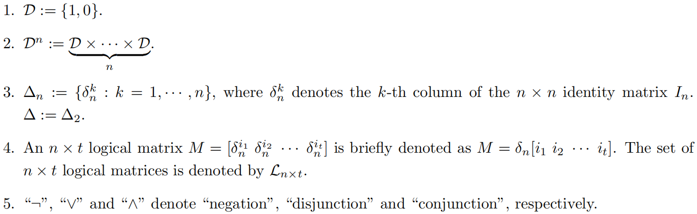
Background
Notations

Slide 13
1. Background
2. Literature Review
3. Function Perturbation
4. Edge Perturbation
5. Illustrative Examples
6. Conclusion

Slide 14

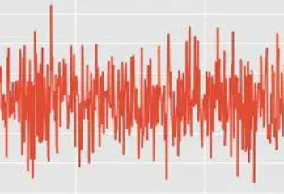
Literature Review
External disturbances
[16] Marie-Julie, F., et al., 2018. Gene-by-environment interactions in urban populations modulate risk phenotypes, Nature Communications, 9: 827.
[17] Imani, M., Braga-Neto, U., 2018. Particle filters for partially-observed Boolean
dynamical systems, Automatica, 87: 238-250.

Slide 15
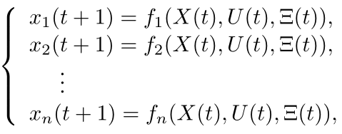
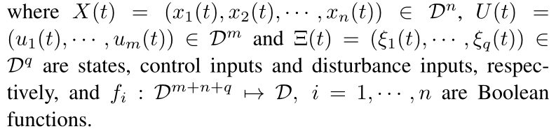
Literature Review
Robust stabilization and DDP of LDSs
(2.1)
[18] Li, H., Wang, Y., 2017. Robust stability and stabilisation of Boolean networks with disturbance inputs, International Journal of Systems Science, 48(4): 750-756.
[19] Feng, J., Li, Y., Fu, S., Lyu, H., 2022. New method for disturbance decoupling of Boolean networks, IEEE Transactions on Automatic Control, 67(9): 4794-4800.

Slide 16
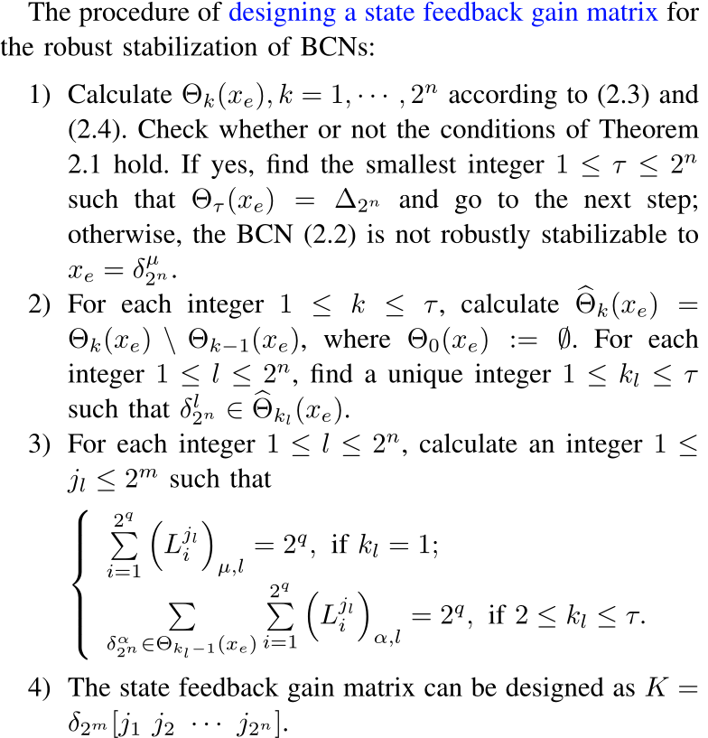


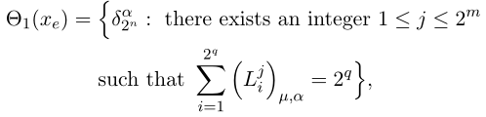
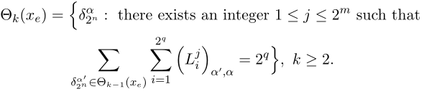
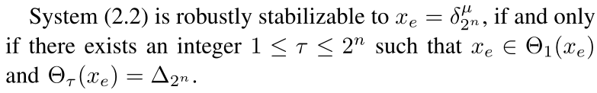
Literature Review
Robust reachable sets
(2.2)
(2.3)
(2.4)
Theorem 2.1

Slide 17
Literature Review
[20] Li, Y., Zhu, J., Li, B., Liu, Y., Lu, J., 2021. A necessary and sufficient graphic condition for the original disturbance decoupling of boolean networks, IEEE Transactions on Automatic Control, 66(8): 3765-3772.
[21] Li, Y., Feng, J., Meng, M., Zhu, J., 2023. Finite-time disturbance decoupling of Boolean control networks, IEEE Transactions on Systems, Man, and Cybernetics: Systems, 53(5): 3199-3207.
[22] Wang, S., Li, H., 2021. New results on the disturbance decoupling problem of Boolean control networks, IEEE Control Systems Letters, 5(4): 1157-1162.
[23] Zhong, J., Ho, D. W. C., Lu, J., Xu, W., 2017. Global robust stability and stabilization of boolean network with disturbances, Automatica, 84: 142-148.
[24] Li, H., Xie, L., Wang, Y., 2016. On robust control invariance of Boolean control networks, Automatica, 68: 392-396.
[25] Sun, Q., Li, H., Gao, H., 2023. Lebesgue sampling approach to robust stabilization of Boolean control networks with external disturbances, Journal of the Franklin Institute, 360(4): 2794-2810.
[26] Wang, S., Li, H., Li, Y., Sun, W., 2020. Event-triggered control for disturbance decoupling problem of mix-valued logical networks, Journal of the Franklin Institute, 357: 796-809.

Slide 18
Literature Review
[27] Imani, M., Dougherty, E., Braga-Neto, U., 2020. Boolean Kalman filter and smoother under model uncertainty, Automatica, 111: 108609.
[28] Guo, Y., Li, Q., Gui, W., 2020. Optimal state estimation of Boolean control networks with stochastic disturbances, IEEE Transactions on Cybernetics, 50(3): 1355-1359.
[29] Chen, H., Wang, Z., Liang, J., Li, M., 2020. State estimation for stochastic time-varying Boolean networks, IEEE Transactions on Automatic Control, 65(12): 5480-5487.
[30] Li, Y., Li, H., Zhao, G., 2020. Optimal state estimation for finite-field networks with stochastic disturbances, Neurocomputing, 414: 238-244.
[31] Ding, X., Li, H., Lu, J., Wang, S., 2022. Optimal strategy estimation of random evolutionary Boolean games, IEEE Transactions on Cybernetics, 52(8): 7899-7905.

Slide 19
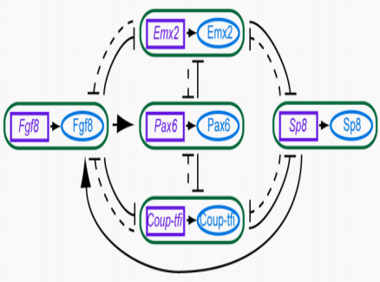
Literature Review
[32] Azuma, S., Yoshida, T., Sugie, T., 2017. Structural monostability of activation-inhibition Boolean networks, IEEE Transactions on Control of Network Systems, 4: 179–190.

Slide 20
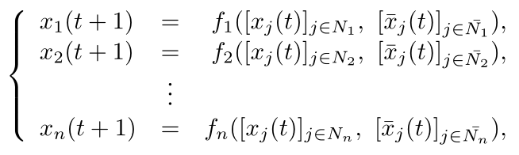
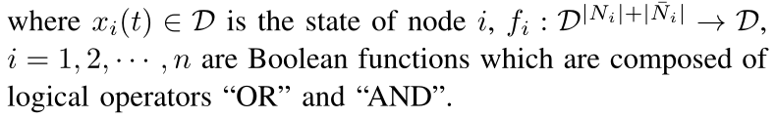
Literature Review
Structural stability and control of LDSs
(2.5)
[33] Zhao, G., Liang, S., Li, H., 2020. Stability analysis of activation-inhibition Boolean networks with stochastic function structures, Mathematical Methods in the Applied Sciences, 43(15): 8694-8705.

Slide 21



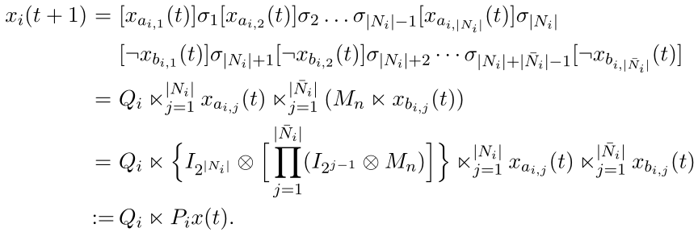
Literature Review
Matrix expression
(2.6)
(2.7)

Slide 22
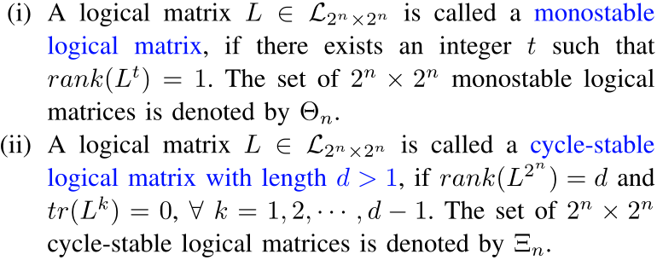
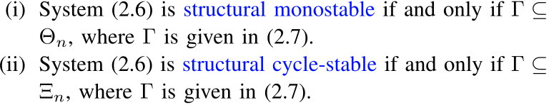
Literature Review
Structural stability analysis
Definition 2.1
Theorem 2.2

Slide 23
Literature Review
[34] Azuma, S. I., Yoshida, T., Sugie, T., 2019. Structural oscillatority analysis of boolean networks, IEEE Transactions on Control of Network Systems, 6(2): 464-473.
[35] Liang, S., Li, H., Wang, S., 2020. Structural controllability of Boolean control networks with unknown function structure, Science China Information Sciences, 63(11): 219203.
[36] Liang, S., Zhao, G., Li, H., Ding, X., 2019. Structural stability analysis of gene regulatory networks modeled by Boolean networks, Mathematical Methods in the Applied Sciences, 42(7): 2221-2230.
[37] Pan, Q., Zhong, J., Tong, S., Li, B., Liu, X., 2021. Structural controllability of Boolean control networks under partial information, Complexity, DOI: 10.1155/2021/9442358.
[38] Zhao, G., Li, H., 2020. Robustness analysis of logical networks and its application in infinite systems, Journal of the Franklin Institute, 357(5): 2882-2891.
[39] Wu, Y., Zhang, J., Shen, T., 2022. A logical network approximation to optimal control on a continuous domain and its application to HEV control, Science China Information Sciences, 65(11): 1-18.

Slide 24
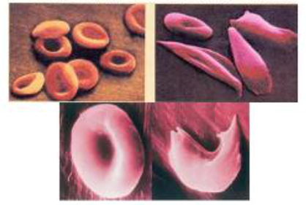
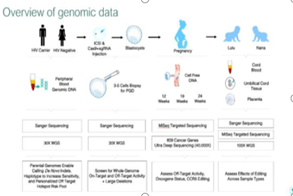

Literature Review
Function perturbation
Gene mutation often occurs in practical GRNs. On one hand, some gene mutations may lead to genetic diseases, e.g., mutations in oncogenes and tumor suppressor genes are very crucial to carcinogenesis. On the other hand, gene mutations sometimes have positive effect on the molecular medicine and molecular evolution.
Normal cells and sickle cells
CCR5 32

Slide 25
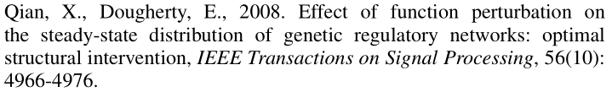
Literature Review
Introduction of function perturbation for LDSs
  Xiao and Dougherty introduced the concept of function perturbation to describe gene mutation, and explored the impact of function perturbation on the attractors of Boolean networks.
  Qian and Dougherty further considered the optimal structural intervention of Boolean networks based on function perturbation.

Slide 26
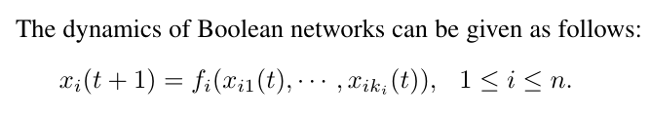
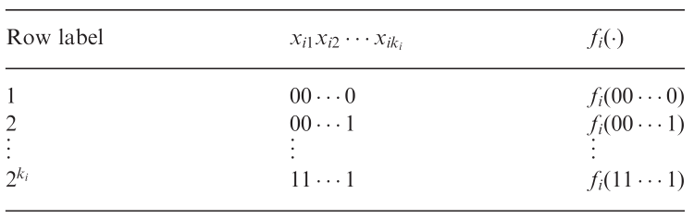
Literature Review
(2.8)
Choose one (multiple) function, and make a one-bit (multi-bit) change of its truth table.

Slide 27
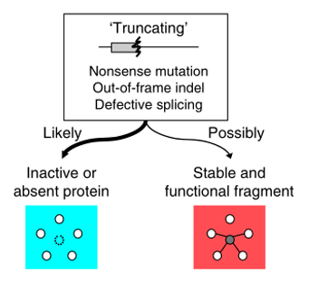
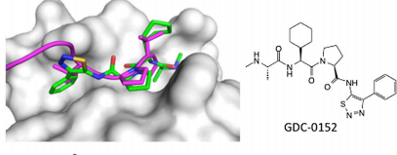

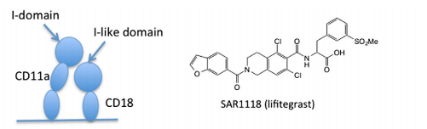
Literature Review
Edge perturbation
Edge perturbation contains edge removal, or decreasing edge strengths [40]. An edge removal can be achieved by the use of therapeutic drugs.
Edge perturbation
Peptide-like inhibitors
[40] Sanhedrai, H., Gao, J., Bashan, A., Schwartz, M., Havlin, S., Barzel, B., 2022. Reviving a failed network through microscopic interventions, Nature Physics, 18: 338-349.

Slide 28
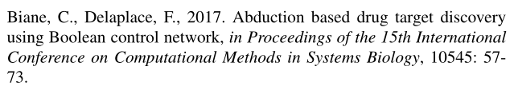

Literature Review
Introduction of edge perturbation for LDSs
  Biane and Delaplace identified the edgetic perturbation in LDSs and reprogramed any abundant state into the desired states.
  Campbell and Albert further took advantage of edgetic perturbation to eliminate undesired fixed-point attractors.

Slide 29


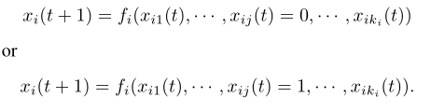
Literature Review
A node’s update rule is modified such that one or more of its regulators is viewed as ON or OFF
(2.9)

Slide 30





Literature Review
  On the other hand, characterizing networks from investigating the edge strength of networks could be a potential way to explore the networks in depth.
  The control input and structural control of PLNs are realized by multiple drugs for the treatment of diseases, where the structural control is described as multiple discrete probability distributions (DPDs).
  PLNs may switch among several different DPDs which can be considered as the change of edge strength of networks.

Slide 31
Literature Review
Feedback control design of gene regulatory networks in the presence of perturbations has important applications in synthetic biology.
It is necessary to develop the robust control theory for LDSs subject to function
perturbation and edge perturbation, including controllability, observability, and
feedback control.

Slide 32
Literature Review
Li, H., Yang, X., Wang, S., 2021. Robustness for stability and stabilization of Boolean networks with stochastic function perturbations, IEEE Transactions on Automatic Control, 66(3): 1231-1237.
Li, H., Yang, X., Wang, S., 2021. Perturbation analysis for finite-time stability and stabilization of probabilistic Boolean networks, IEEE Transactions on Cybernetics, 51(9): 4623-4633.
Li, H., Wang, S., Li, X., Zhao, G., 2020. Perturbation analysis for controllability of logical control networks, SIAM Journal on Control and Optimization, 58(6): 3632-3657.
Li, H., Yang, X., 2023. Robust optimal control of logical control networks with function perturbation, Automatica, 152: 110970.
Wang, S., Li, H., 2022. Graph-based function perturbation analysis for observability of multi-valued logical networks, IEEE Transactions on Neural Networks and Learning Systems, 9(3): 1261-1270.
Yang, X., Li, H., 2023. Stability analysis of probabilistic Boolean networks with switching discrete probability distribution, IEEE Transactions on Automatic Control, 68(4): 2506-2512.

Slide 33
Literature Review
Liu, Y., Li, B., Chen, H., Cao, J., 2017. Function perturbations on singular Boolean networks, Automatica, 84: 36-42.
Jia, G., Meng, M., Lam, J., Feng, J., 2021. Further results for pinning stabilization of Boolean networks, IEEE Transactions on Control of Network Systems, 8(2): 897-905.
Li, X., Li, H., Zhao, G., 2019. Function perturbation impact on feedback stabilization of Boolean control networks, IEEE Transactions on Neural Networks and Learning Systems, 30(8): 2548-2554.
Yang, X., Li, H., 2023. Reachability, controllability and stabilization of Boolean control networks with stochastic function perturbations, IEEE Transactions on Systems, Man, and Cybernetics: Systems, 53(2): 1198-1208.
Chen, Q., Li, H., 2022. Robust weak detectability analysis of Boolean networks subject to function perturbation, IEEE Transactions on Circuits and Systems II: Express Briefs, 69(12): 5004-5008.
Chen, Q., Li, H., Yang, X., 2023. Total-activity conservation analysis and design of Boolean networks, IEEE Transactions on Cybernetics, DOI: 10.1109/TCYB.2022.3163608.
Wang, S., Li, H., 2022. Robust set controllability of logical control networks: A set monotonicity approach, IEEE Transactions on Control of Network Systems, 9(3): 1261-1270.

Slide 34
Literature Review
Tong, L., Liang, J., 2021. Function perturbation impact on conjunctive Boolean networks under asynchronous update, 2021 International Symposium on Computer Science and Intelligent Controls (ISCSIC). IEEE, 416-421.
Ren, Y., Ding, X., Zhong, J., et al., 2021. Robust stability in distribution of Boolean networks under multi-bits stochastic function perturbations, Nonlinear Analysis: Hybrid Systems, 42: 101095.
Wu, J., Liu, Y., Ruan, Q., et al., 2022. Robust stability of switched Boolean networks with function perturbation, Nonlinear Analysis: Hybrid Systems, 46: 101216.
Li, L., Zhang, A., Lu, J., 2022. Robust set stability of probabilistic Boolean networks under general stochastic function perturbation, Information Sciences, 582: 833-849.
Deng, L., Fu, S., Wang, J., et al, 2023. Function perturbation impact on robust stability and stabilization of Boolean networks with disturbances, IEEE Access, DOI: 10.1109/ACCESS.2023.3303481.

Slide 35
1. Background
2. Literature Review
3. Function Perturbation
4. Edge Perturbation
5. Illustrative Examples
6. Conclusion

Slide 36
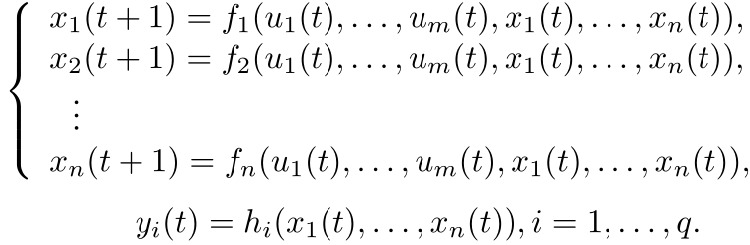
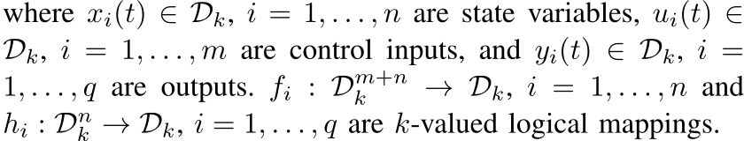
Robust Stabilization
Logical control networks
(3.1)
Li, H., Yang, X., Wang, S., 2021. Robustness for stability and stabilization of Boolean networks with stochastic function perturbations, IEEE Transactions on Automatic Control, 66(3): 1231-1237.

Slide 37
Feedback controls
When studying the stabilization problem of LCNs, both state
feedback control
(3.2)
and output feedback control
(3.3)
are often concerned.

Slide 38

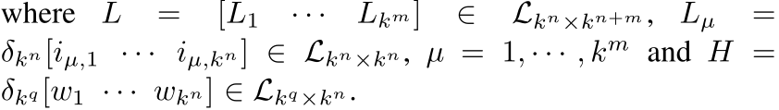


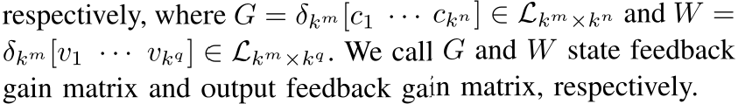
Algebraic state space representation
(3.4)
The equivalent algebraic forms of (3.2) and (3.3) are
(3.5)
(3.6)

Slide 39
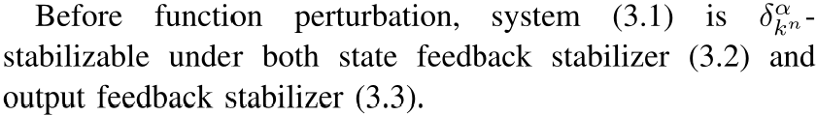
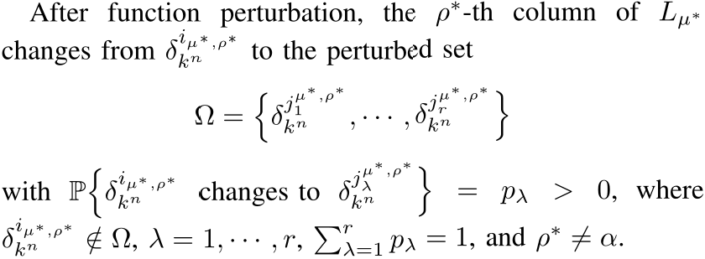
Function perturbation
Assumption 3.1
Assumption 3.2

Slide 40
Closed-loop system
(3.7)

Slide 41
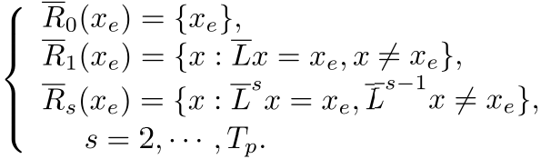
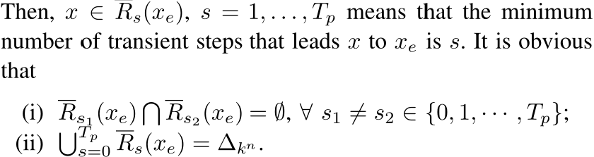
Reachable sets

Slide 42

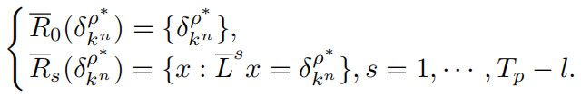
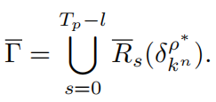
Parameterized set
(3.8)

Slide 43
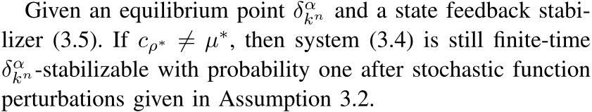
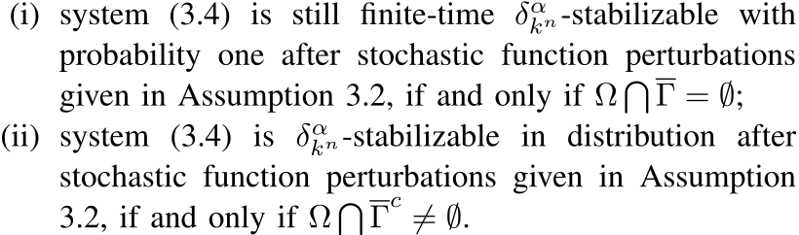
Main results
Theorem 3.1
Theorem 3.2

Slide 44


Proof sketch of Theorem 3.2

Slide 45


Robust Controllability
Definition of controbability
(3.9)
Definition 3.1
Li, H., Wang, S., Li, X., Zhao, G., 2020. Perturbation analysis for controllability of logical control networks, SIAM Journal on Control and Optimization, 58(6): 3632-3657.

Slide 46



Verification of controbability
(3.10)
(3.11)
Lemma 3.1

Slide 47



Function perturbation
Assumption 3.3

Slide 48


Main idea
(3.12)

Slide 49



Two important parameterized sets
Case 1 makes controllability remain unchanged
Theorem 3.3

Slide 50


Case 2 increases controllability
Theorem 3.4
Theorem 3.5
(3.13)

Slide 51


Case 3 decreases controllability
Theorem 3.6
Theorem 3.7
(3.14)

Slide 52


Case 4 makes indefinite change of controllability
Theorem 3.8
(3.15)
Remark 3.1

Slide 53
1. Background
2. Literature Review
3. Function Perturbation
4. Edge Perturbation
5. Illustrative Examples
6. Conclusion

Slide 54



Edge Removal
Dynamics of LNs
(4.1)

Slide 55



Edge removal control
Proposition 4.1
(4.2)

Slide 56





LNs with edge removal control
(4.4)

Slide 57



Edge driving point reachability
Define the following edge driving reachability matrix:
(4.5)
Lemma 4.1
(4.6)
(4.7)

Slide 58




Stabilizability under arbitrary edge removal control
Definition 4.1
Proposition 4.2
Theorem 4.1
(4.8)

Slide 59


Stabilizability under edge removal control
Definition 4.2
Assumption 4.1
Theorem 4.2
(4.9)

Slide 60



Switching DPD
LNs with switching DPDs
(4.10)
Yang, X., Li, H., 2023. Stability analysis of probabilistic Boolean networks with switching discrete probability distribution, IEEE Transactions on Automatic Control, 68(4): 2506-2512.

Slide 61



Finite-time stability and stability in distribution
Definition 4.3
Definition 4.4

Slide 62


Algebraic state space representation
(4.11)

Slide 63






Switching transition probability matrix
Define the following switching transition probability matrix:
(4.12)
(4.13)

Slide 64




Expectation of number of trajectories
Definition 4.5
(4.14)

Slide 65






Calculation of ENT
Proposition 4.3
(4.15)
Theorem 4.3
(4.16)

Slide 66


Proof sketch of Theorem 4.3

Slide 67





Stability analysis
Theorem 4.4
(4.17)
Theorem 4.5
(4.18)
(4.19)

Slide 68



Proof sketch of Theorem 4.5
(4.20)
(4.23)
(4.21)
(4.22)

Slide 69


Further discussions

Slide 70
1. Background
2. Literature Review
3. Function Perturbation
4. Edge Perturbation
5. Illustrative Examples
6. Conclusion

Slide 71



Illustrative Examples
Example 5.1
Consider a reduced model of the lac operon in the Escherichia coli [41], whose dynamic equations are given as follows:
(5.1)
Fig 5.1: The network graph of system (5.1).
[41] Robeva, R., Hodge, T., 2013. Mathematical Concepts and Methods in Modern Biology: Using Modern Discrete Models, Academic Press.

Slide 72



Illustrative Examples
The algebraic form of system (5.1):
(5.2)
The state feedback controller stabilizes the system (5.2) to the equilibrium , which corresponds to the operon being 'on'.

Slide 73

Illustrative Examples
We study the robustness of with the following two kinds of fabricated stochastic function perturbations:

Slide 74



Illustrative Examples

Slide 75


Illustrative Examples
3.1,

Slide 76



Illustrative Examples
3.2,
Fig 5.2: The probability trajectory of equilibrium for system (5.2) with the stochastic function perturbations in (ii), where x(0) = and . .

Slide 77




Illustrative Examples
Example 5.2
where x1 denotes morphogen Fgf8, x2, x3, x4 and x5 denote transaction factors Emx2, Pax6, Coup-tfi and Sp8, respectively.
Fig 5.3: The wiring diagram of mammalian cortical area development. The solid lines indicate interactions that must be present, while the dashed lines indicate interactions that can be present or absent.
[42] Clare, E., Geoffrey, J., 2010. A Boolean model of the gene regulatory network underlying mammalian cortical area development, PLoS Computational Biology, 6(9): e1000936.

Slide 78


Illustrative Examples
(5.6)

Slide 79



Illustrative Examples

Slide 80

Illustrative Examples
The algebraic form of system (5.6):
(5.7)

Slide 81




Illustrative Examples
Theorem 4.2,

Slide 82




Illustrative Examples

Slide 83




Illustrative Examples
Fig5.4:
Fig5.5:

Slide 84
1. Background
2. Literature Review
3. Function Perturbation
4. Edge Perturbation
5. Illustrative Examples
6. Conclusion

Slide 85
Conclusion
We have presented some new citeria for the robust stabilization and controllability of LCNs subject to function perturbations.
We have developed a new edge removal mechanism and proposed several new criteria for the global stabilizability and set stabilizability of LNs with edge removal control.
We have proposed the concepts of ENT and state expectation matrix, and provided some interesting criteria for the finite-time stability and asymptotical stability of PLNs with switching DPD.

Slide 86
Conclusion
One can generalize the obtained results to synchronization, output tracking and partial stabilization of Boolean control networks with respect to function perturbation and edge perturbation.
One can apply our graph-based framework to the robustness of observers and the identification of perturbed LDSs.
Reduction of computational complexity deserves further study.
Applications of theoretical results to the intervention of diseases, the incentive-based control of games, etc.
Future works contain the following contents:

Slide 87
Conclusion
Li, W., Li, H., 2023. Edge removal and Q-learning for stabilizability of Boolean networks, submitted to IEEE Transactions on Neural Networks and Learning Systems.
Liu, Z., Li, H., 2023. Identification and stabilization of faulty Boolean control networks, Journal of the Franklin Institute, DOI: 10.1016/j.jfranklin.2023.08.012.
Yang, X., Li, H., 2023. Robust synchronization of coupled logical networks subject to stochastic function perturbations, submitted to Information Sciences.
Liu, Z., Li, H., 2023. Controllability and observability of Boolean control networks subject to stuck-at fault, submitted to Nonlinear Analysis: Hybrid Systems.
Li, W., Li, H., Yang, X., 2023. Edge removal towards asymptotical stabilizability of Boolean networks under asynchronous stochastic update, Systems & Control Letters, Provisionally Accepted.
Li, W., Li, H., Yang, X., 2023. Identification of edge removal fault in Boolean networks and disjunctive Boolean networks, submitted to Journal of the Franklin Institute.
Yang, X., Li, H., 2023. Robust reconstructibility of Boolean networks subject to function perturbation, submitted to SIAM Journal on Control and Optimization.
Li, W., Li, H., Yang, X., 2023. Robust stability of Boolean networks subject to two kinds of edge perturbations, submitted to IEEE Transactions on Control of Network Systems.

Slide 88



Related Works
[43] R. Zhou, Y. Guo, X. Liu, and W. Gui, Stabilization of Boolean control networks with state-triggered impulses, Science China Information Sciences, 65(3): 132202, 2022.
[44] J. Yue, Y. Yan, Z. Chen, and H. Deng, Further results on bilinear behavior formulation of finite state machines, Science China Information Sciences, 65(11): 219201, 2022.
[45] Y. Liu, J. Zhong, D. W. C. Ho, and W. Gui, Minimal observability of Boolean networks, Science China Information Sciences, 65(5): 152203, 2022.
[46] Y. Yan, D. Cheng, J. Feng, H. Li, and J. Yue, Survey on applications of algebraic state space theory of logical systems to finite state machines, Science China Information Sciences, 66(1): 111201, 2023.
[47] S. Wang, and H. Li, Aggregation method to reachability and optimal control of large-size Boolean control networks, Science China Information Sciences, 66(7): 179202, 2023.

Slide 89





Journal website
https://www.aimspress.com/journal/mmc
Mathematical Modelling and Control
Aims and Scope
Mathematical Modelling and Control (MMC) highlights contributions that represent significant advances in mathematical modelling and mathematical control in the field of science and engineering. The subjects include dynamical systems, differential equations, mathematical biology, complex networks, artificial intelligence, engineering processes, and other related topics. It provides an effective medium for research mathematicians and a way to quickly publish high-quality original papers, so as to convey the latest important progress in their professional field to colleagues and scientists in related disciplines.
The journal is completely free of costs for publication.
ISSN (Online): 2767-8946
Impact Factor:1.6

Slide 90

      Thank you !

